Slide 1


Data Governance @ SneakerPark
Prepared by: Arjun Avalakki Mohan
Submitted on:

Slide 2
Background
SneakerPark is an online shoe reseller that allows people to buy and sell used and new shoes. Buyers can bid for shoes or buy them outright, and sellers can set a price or sell to the highest bidder.
Each buyer and seller must have an active account in order to sell, bid, or purchase sneakers using SneakerPark’s website.
SneakerPark authenticates the shoes before shipping them to the buyer, so before listing an item, the seller must ship it to SneakerPark’s warehouse. Upon receipt, SneakerPark assigns an item number to each pair of sneakers and notifies the seller that they are now free to list their item. If the item is not listed within 45 days, SneakerPark returns it to the seller and sends an invoice to the seller for the shipping cost.
If the item is found to be inauthentic or in an unacceptable condition, it is also returned back to the seller in a similar fashion.
When the item sells, the buyer’s account is credited with the purchase price minus the SneakerPark service fee and shipping fees to deliver the item to the buyer.
Currently, SneakerPark only supports sales within the United States.

Slide 3
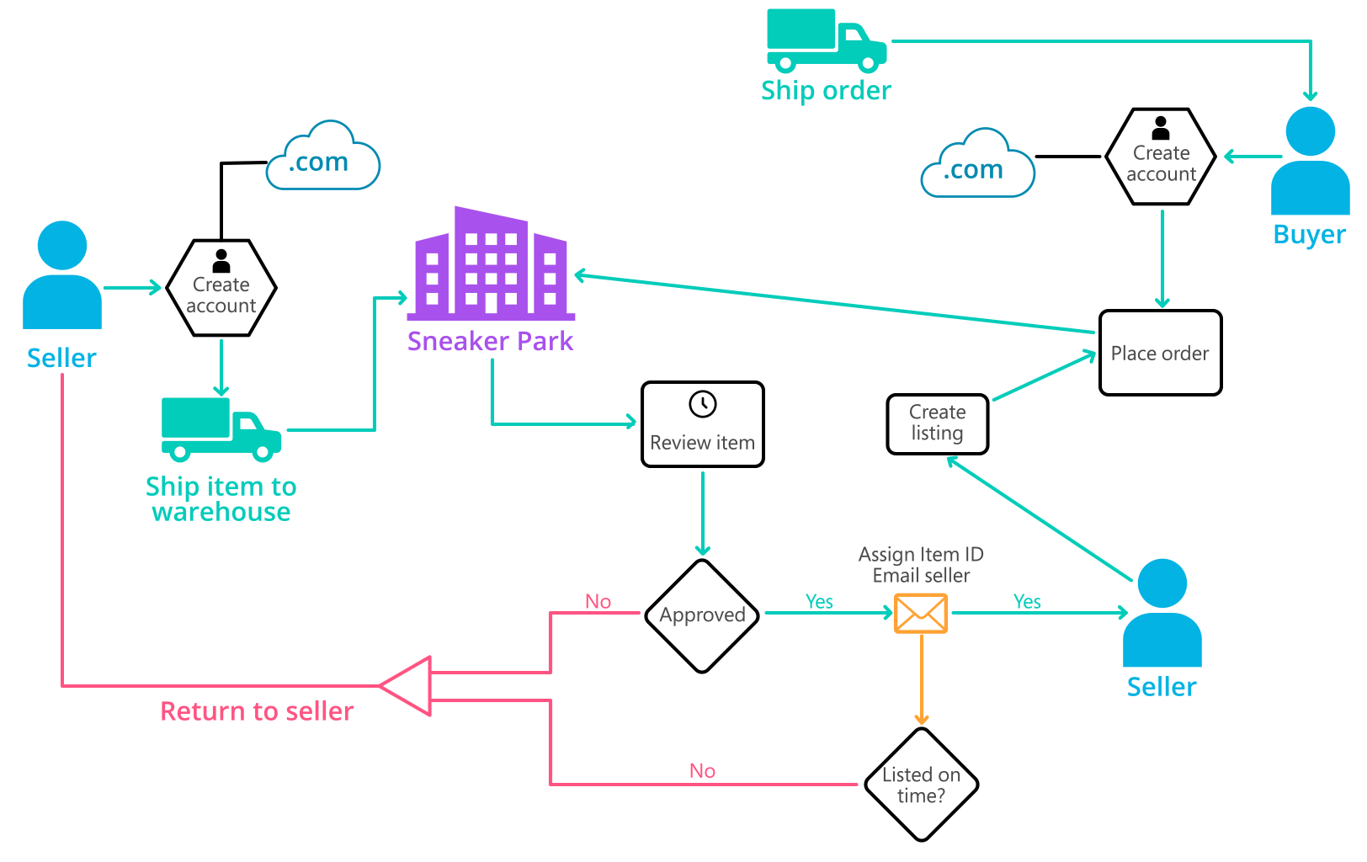
Background (cont’d)
Below you can see a diagram that will hopefully help you visualize some of SneakerPark's business processes. Keep in mind that it does not capture ALL processes and every nuance, but simply serves as another artifact to use in your project.

Slide 4
Step 1
Enterprise Data Catalog Part 1: Enterprise Data Model

Slide 5
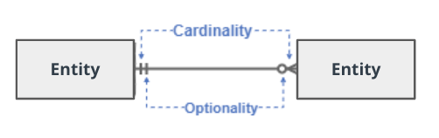
Create a conceptual data model that will provide SneakerPark with a holistic view of its data systems and help you grasp the organization's important entities and relationships, which will be instrumental as you move further in the project. You can use Lucidchart or any other diagramming tool of your choice, but please use the Crow’s Foot/IE Notation and please be sure to indicate both cardinality (the type of a relationship such as 1:N or N:N) and optionality (whether the relationship is optional or mandatory).

Slide 6
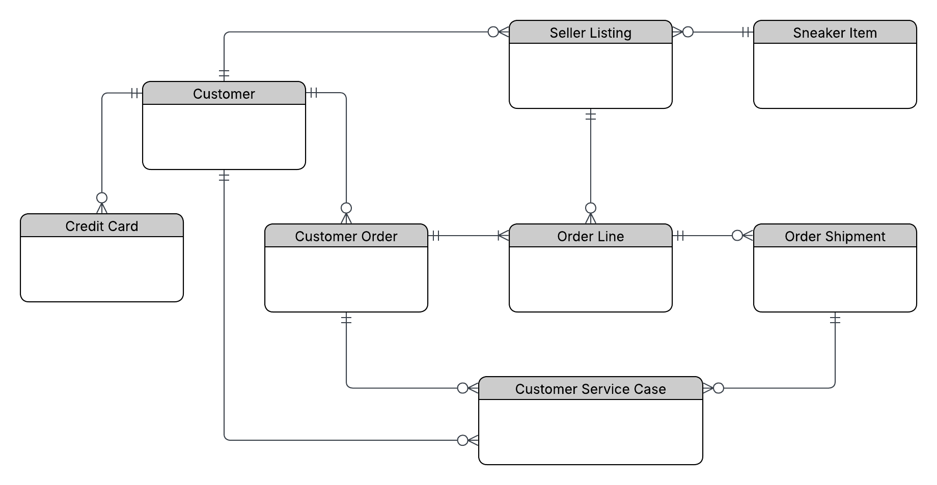
SneakerPark – Enterprise Conceptual Data Model

Slide 7
Step 2
Enterprise Data Catalog Part 2: Metadata

Slide 8
The metadata for all source systems was documented in the Data Dictionary and Enterprise Data Catalog tabs of the provided spreadsheet template. Please refer to the attached Metadata Catalog spreadsheet for full details.

Slide 9
Step 3
Data Quality
Part 1: Profiling and Cleansing

Slide 10
Profile the data to identify at least 3 data quality issues you see in the data. Also provide at least 1 data quality issue that you haven’t yet seen in the data, but can foresee occurring in the future. Based on the issues you’ve identified, come up with the data quality rule for each data quality issue, including for the one that you foresee.
Make sure you fill out all columns in the "Data Quality Issues" tab with your answers in the provided Sheets template.

Slide 11
Step 4
Data Quality
Part 2: Monitoring

Slide 12
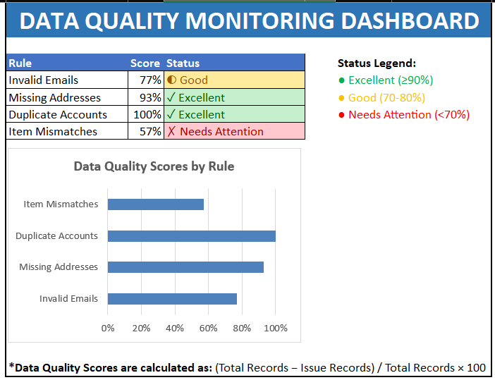
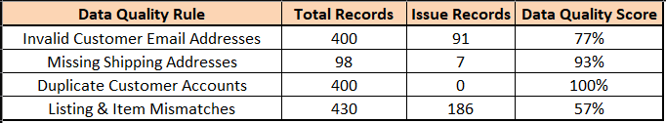
The dashboard highlights data quality issues identified during profiling of the SneakerPark data. The most significant issues are invalid customer email addresses and inconsistencies between listing information and inventory item data. Missing shipping addresses were identified in a smaller number of order records. While no duplicate customer accounts were found in the current dataset, this remains a potential future risk as the business continues to grow.
These metrics should be monitored regularly to ensure compliance with data quality rules and to support future Master Data Management initiatives.

Slide 13
Step 5
Master Data Management
Part 1: MDM Architecture

Slide 14
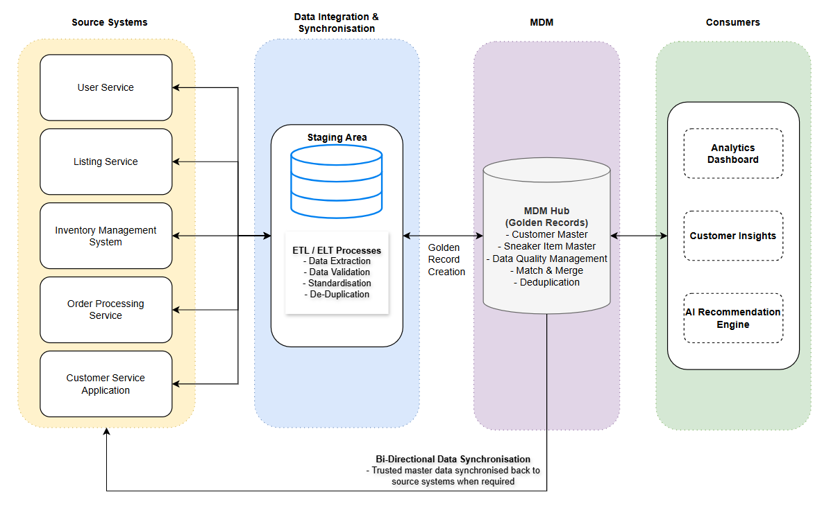
SNEAKERPARK HYBRID (COEXISTENCE)
MDM ARCHITECTURE

Slide 15
Explanation:
I chose the Hybrid (Co-Existence) MDM approach because SneakerPark already has several systems that manage different parts of the business, such as customers, listings, inventory, orders and customer service. Replacing these systems with a fully centralised solution would require significant changes and could disrupt existing operations. The Hybrid approach allows these systems to continue working as they do today while sharing trusted master data through a central MDM Hub.
The source systems continue to create and maintain operational data, while important customer and product information is shared with the MDM Hub.
Data from the source systems is first loaded into a staging area. During this process, the data is validated, standardised and checked for duplicates. This helps improve data quality before the information is loaded into the MDM Hub.
The MDM Hub acts as the central location for trusted master data. It stores the Golden Records for customers and sneaker items and applies data quality, matching and deduplication rules. This creates a single source of truth that can be used across the business.
This architecture also supports bi-directional synchronisation. When master data is corrected, standardised or merged within the MDM Hub, trusted data can be synchronised back to operational systems to improve consistency across the organisation.
The trusted data from the MDM Hub can then be used by “Analytics Dashboard”, “Customer Insights” and “AI Recommendation Engine”
The main benefits of this approach are:
Improved data quality and consistency.
Reduced duplicate records.
A single source of truth for customer and product data.
Minimal impact on existing systems.
Better support for reporting, analytics and future AI initiatives.
Overall, the Hybrid (Co-Existence) MDM approach provides a practical way for SneakerPark to improve data quality and governance without making major changes to its existing systems.

Slide 16
Step 6
Master Data Management
Part 2: Master Record

Slide 17
Entity | Rule Name | Matching Rule
Customer | Customer Email Match | Match customer records when the Email Address is identical across multiple systems. Provides a high-confidence match because email addresses are expected to be unique for each customer.
Customer | Customer Name & Address Match | Match customer records when both the Customer Name and Postal Address are identical. This will be used as a fallback when email addresses are missing, invalid, or have changed.
Sneaker Item | Item ID Match | Match sneaker item records when the Item ID is identical across systems. Provides a direct and reliable match for the same sneaker item.
Sneaker Item | Product Attribute Match | Match sneaker item records when Item Name, Brand, and Condition are identical. Used when Item IDs are inconsistent between systems. Helps identify the same product based on business attributes.

Slide 18
Step 7
Data Governance:
Roles and Responsibilities

Slide 19
To support the new Data Management initiative, SneakerPark should establish clear data governance roles and responsibilities.
Data Quality Management
Data Stewards should be responsible for monitoring data quality issues, defining data quality rules and working with business teams to resolve data issues. This will help improve the accuracy, completeness and consistency of customer, item and order data across the organisation.
Metadata Management
Data Architect should be responsible for maintaining the enterprise data model, data catalog and business glossary. This role will ensure that data definitions remain consistent across systems and that users have a clear understanding of the data available within the organisation.
Master Data Management (MDM)
Both Data Stewards and the Data Architect should work together to define matching rules, manage golden records and oversee the MDM Hub to ensure a single source of truth for customer and sneaker item data.
Based on the information provided, Jessica already has strong business knowledge and would be a good candidate for a Data Steward role because she understands the company's data and business processes. Jake has experience managing the company's databases and could continue supporting the technical aspects of the platform.
However, neither employee appears to have formal experience in enterprise data governance or MDM. Therefore, SneakerPark should consider hiring a dedicated Data Architect or Data Governance Manager to lead the programme and establish governance standards, policies and processes as the company continues to grow.

